Slide 1
HW2 Solutions
Dr. Shengquan Wang

Slide 2
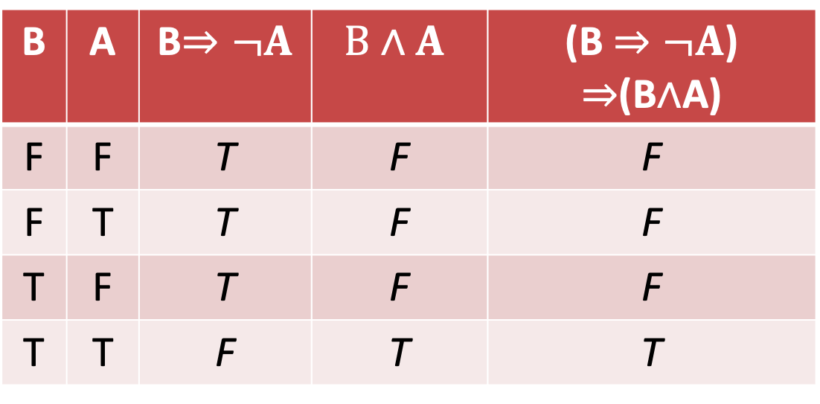
Q2.1
B | A | B$⇒¬A$ | $$B∧A$$ | (B $⇒¬A$) $⇒$(B$∧$A)
F | F | T | F | F
F | T | T | F | F
T | F | T | F | F
T | T | F | T | T

Slide 3
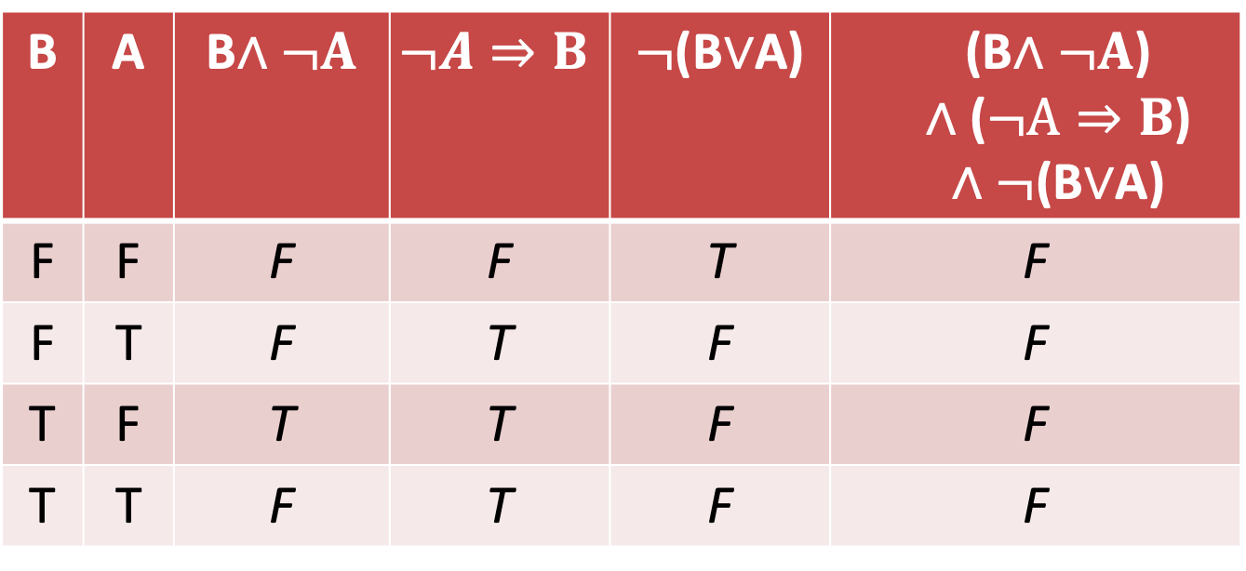
Q2.2
B | A | B$∧¬A$ | $$¬A⇒B$$ | $¬$(B$∨$A) | (B$∧¬A$) $$∧\text{(}¬A⇒B\text{)}$$ $∧¬$(B$∨$A)
F | F | F | F | T | F
F | T | F | T | F | F
T | F | T | T | F | F
T | T | F | T | F | F

Slide 4



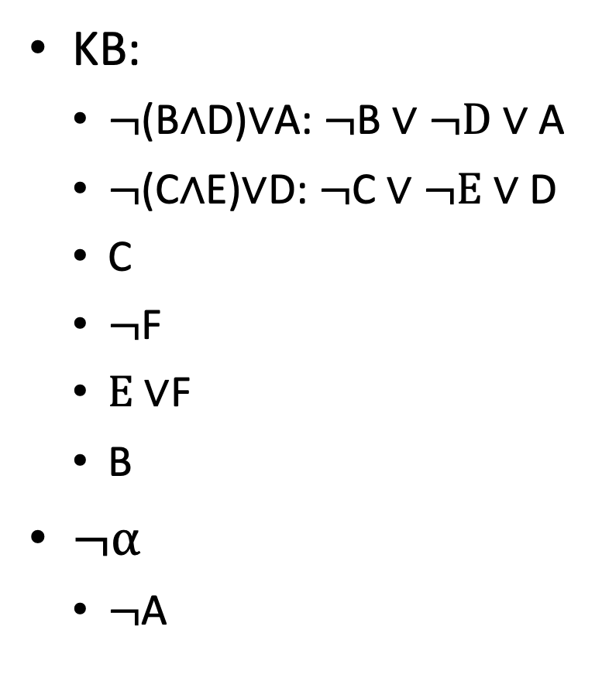




Q3
KB:
$¬$(B$∧$D)$∨$A: $¬$B $∨¬D∨$A
$¬$(C$∧$E)$∨$D: $¬$C $∨¬E∨$D
C
$¬$F
$E∨$F
B
$¬α$
$¬$A
KB $∧¬α$
$¬$B $∨¬D∨$A
$¬$C $∨¬E∨$D
C
¬F
$E$∨F
B
¬A
$¬D∨$A
$¬E$ $∨D$
$$E$$
D
A

Slide 5
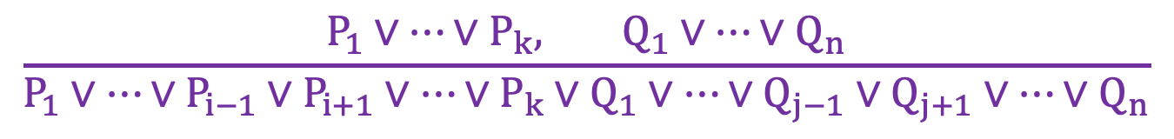
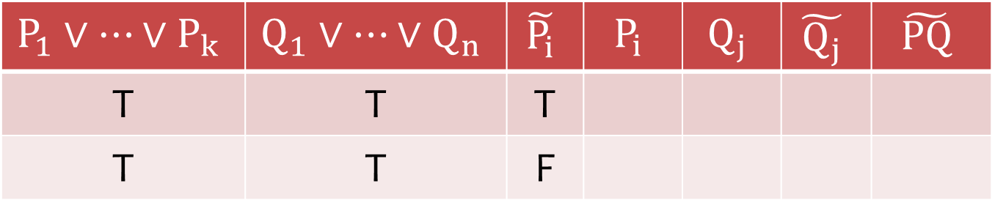

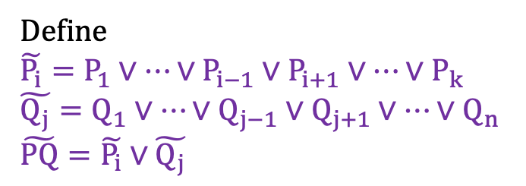
Q4.1 (Truth Table Approach)
$$\frac{P_{1}∨⋯∨P_{k}, Q_{1}∨⋯∨Q_{n}}{P_{1}∨⋯∨P_{i−1}∨P_{i+1}∨⋯∨P_{k}∨Q_{1}∨⋯∨Q_{j−1}∨Q_{j+1}∨⋯∨Q_{n}}$$
$$P_{i}\text{≡}¬Q_{j}$$
Define
$$\tilde{P_{i}}=P_{1}∨⋯∨P_{i−1}∨P_{i+1}∨⋯∨P_{k}$$
$$\tilde{Q_{j}}=Q_{1}∨⋯∨Q_{j−1}∨Q_{j+1}∨⋯∨Q_{n}$$
$$\tilde{PQ}=\tilde{P_{i}}∨\tilde{Q_{j}}$$
$$P_{1}∨⋯∨P_{k}$$ | $$Q_{1}∨⋯∨Q_{n}$$ | $$\tilde{P_{i}}$$ | $$P_{i}$$ | $$Q_{j}$$ | $$\tilde{Q_{j}}$$ | $$\tilde{PQ}$$
T | T | T
T | T | F
T
T
F
T
T

Slide 6
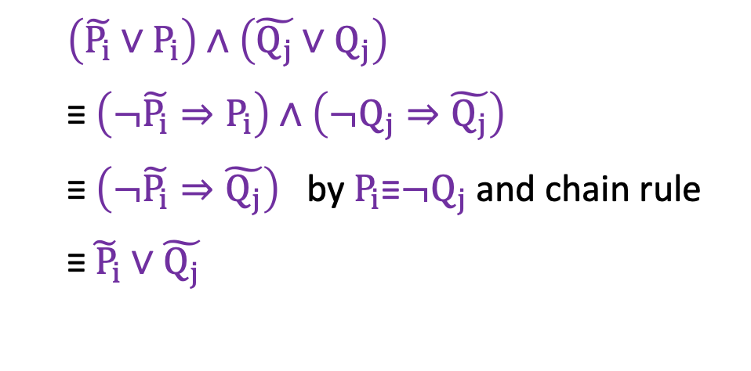
Q4.1 (Chain Rule Approach)
$$\frac{P_{1}∨⋯∨P_{k}, Q_{1}∨⋯∨Q_{n}}{P_{1}∨⋯∨P_{i−1}∨P_{i+1}∨⋯∨P_{k}∨Q_{1}∨⋯∨Q_{j−1}∨Q_{j+1}∨⋯∨Q_{n}}$$
$$P_{i}\text{≡}¬Q_{j}$$
Define
$$\tilde{P_{i}}=P_{1}∨⋯∨P_{i−1}∨P_{i+1}∨⋯∨P_{k}$$
$$\tilde{Q_{j}}=Q_{1}∨⋯∨Q_{j−1}∨Q_{j+1}∨⋯∨Q_{n}$$
$$\tilde{PQ}=\tilde{P_{i}}∨\tilde{Q_{j}}$$
$\left(\tilde{P_{i}}∨P_{i}\right)∧\left(\tilde{Q_{j}}∨Q_{j}\right)$
$\text{≡} \left(¬\tilde{P_{i}}⇒P_{i}\right)$ $∧\left(¬Q_{j}⇒\tilde{Q_{j}}\right)$
$\text{≡} \left(¬\tilde{P_{i}}⇒\tilde{Q_{j}}\right)$ by $P_{i}\text{≡}¬Q_{j}$and chain rule
$\text{≡}\tilde{{ P}_{i}}∨\tilde{Q_{j}}$

Slide 7
Q4.2
We consider Horn clauses C1 and C2. Then both C1 and C2 have at most one positive literal.
After the resolution, one positive and one negative will be cancelled out. Then the resolved clause still has at least one positive literal. Therefore, the resolved clause is still a Horn clause.

Slide 8
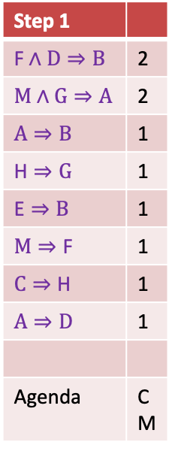
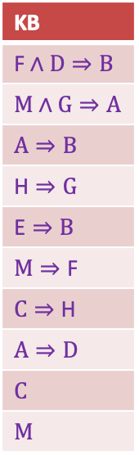
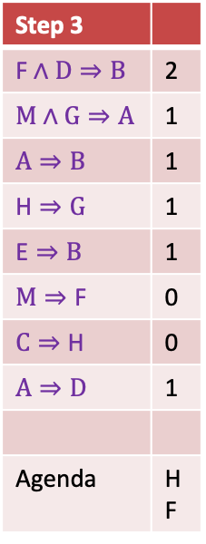
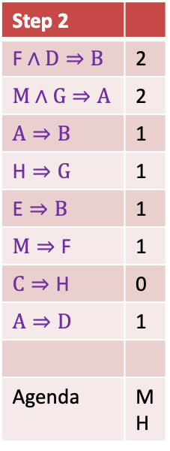
Q5
KB
$$\text{F}∧D⇒B$$
$$M∧G⇒A$$
$$A⇒B$$
$$\text{H}⇒G$$
$$\text{E}⇒B$$
$$M⇒\text{F}$$
$$C⇒\text{H}$$
$$A⇒D$$
$$C$$
$$M$$
Step 1
$$\text{F}∧D⇒B$$ | 2
$$M∧G⇒A$$ | 2
$$A⇒B$$ | 1
$$\text{H}⇒G$$ | 1
$$\text{E}⇒B$$ | 1
$$M⇒\text{F}$$ | 1
$$C⇒\text{H}$$ | 1
$$A⇒D$$ | 1
Agenda | C M
Step 2
$$\text{F}∧D⇒B$$ | 2
$$M∧G⇒A$$ | 2
$$A⇒B$$ | 1
$$\text{H}⇒G$$ | 1
$$\text{E}⇒B$$ | 1
$$M⇒\text{F}$$ | 1
$$C⇒\text{H}$$ | 0
$$A⇒D$$ | 1
Agenda | M H
Step 3
$$\text{F}∧D⇒B$$ | 2
$$M∧G⇒A$$ | 1
$$A⇒B$$ | 1
$$\text{H}⇒G$$ | 1
$$\text{E}⇒B$$ | 1
$$M⇒\text{F}$$ | 0
$$C⇒\text{H}$$ | 0
$$A⇒D$$ | 1
Agenda | H F

Slide 9

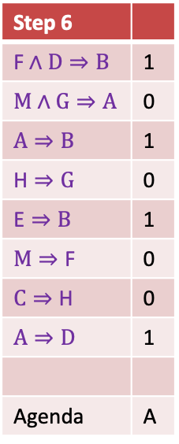

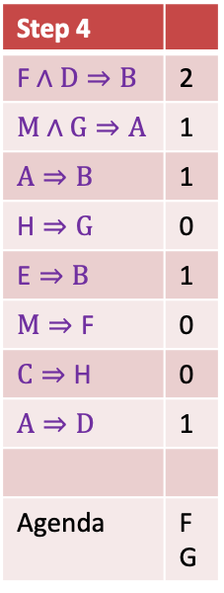
Q5
Step 4
$$\text{F}∧D⇒B$$ | 2
$$M∧G⇒A$$ | 1
$$A⇒B$$ | 1
$$\text{H}⇒G$$ | 0
$$\text{E}⇒B$$ | 1
$$M⇒\text{F}$$ | 0
$$C⇒\text{H}$$ | 0
$$A⇒D$$ | 1
Agenda | F G
Step 5
$$\text{F}∧D⇒B$$ | 1
$$M∧G⇒A$$ | 1
$$A⇒B$$ | 1
$$\text{H}⇒G$$ | 0
$$\text{E}⇒B$$ | 1
$$M⇒\text{F}$$ | 0
$$C⇒\text{H}$$ | 0
$$A⇒D$$ | 1
Agenda | G
Step 6
$$\text{F}∧D⇒B$$ | 1
$$M∧G⇒A$$ | 0
$$A⇒B$$ | 1
$$\text{H}⇒G$$ | 0
$$\text{E}⇒B$$ | 1
$$M⇒\text{F}$$ | 0
$$C⇒\text{H}$$ | 0
$$A⇒D$$ | 1
Agenda | A
Step 7
$$\text{F}∧D⇒B$$ | 1
$$M∧G⇒A$$ | 0
$$A⇒B$$ | 0
$$\text{H}⇒G$$ | 0
$$\text{E}⇒B$$ | 1
$$M⇒\text{F}$$ | 0
$$C⇒\text{H}$$ | 0
$$A⇒D$$ | 0
Agenda | B D

Slide 10

Q6.1
P(f|c) $∝$ P(f,c) = P(c|f)P(f) = 0.7*0.8 = 0.56
P(¬f|c) $∝$ P(¬f,c) = P(c|¬f)P(¬f) = 0.2*0.2 = 0.04
P(¬f|c) = 0.04/(0.56+0.04) = 0.0667

Slide 11
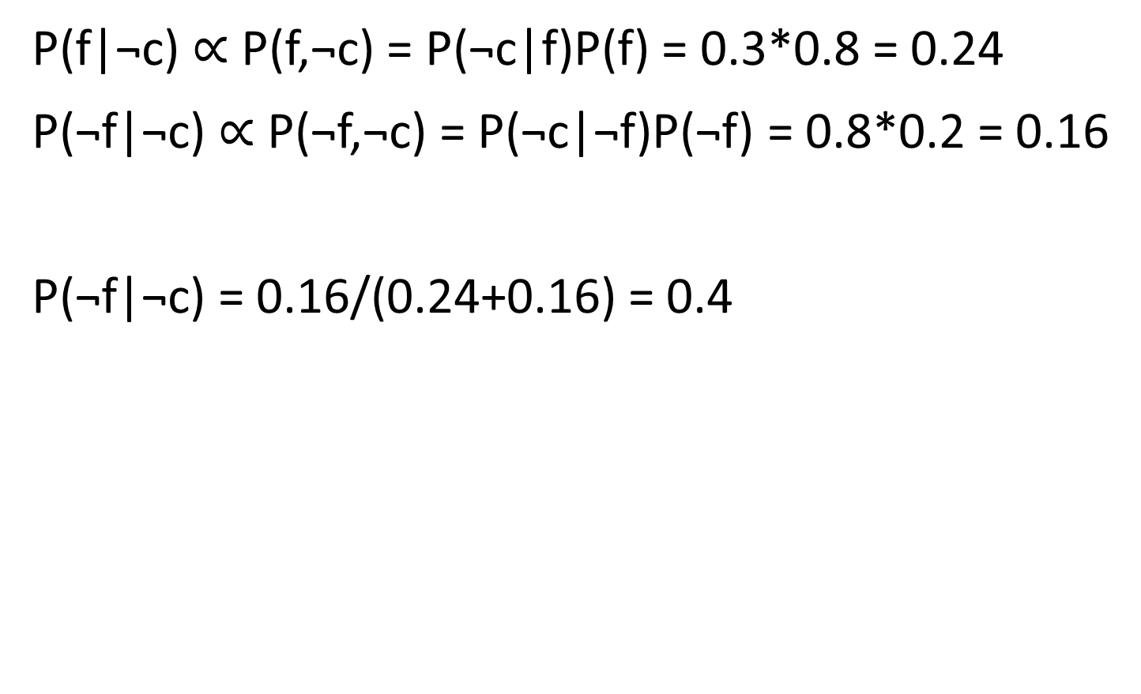
Q6.2
P(f|¬c) $∝$ P(f,¬c) = P(¬c|f)P(f) = 0.3*0.8 = 0.24
P(¬f|¬c) $∝$ P(¬f,¬c) = P(¬c|¬f)P(¬f) = 0.8*0.2 = 0.16
P(¬f|¬c) = 0.16/(0.24+0.16) = 0.4

Slide 12
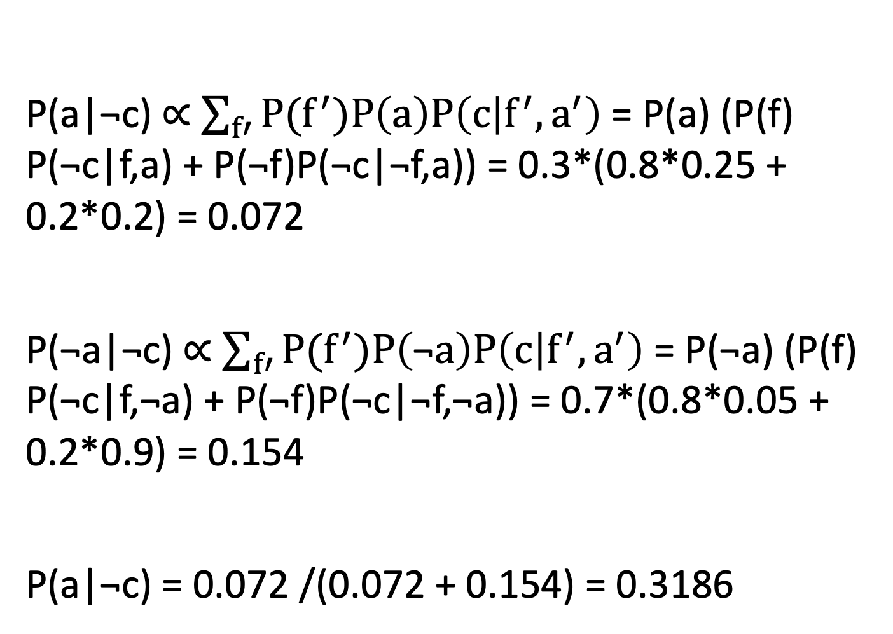
Q7.1
P(a|¬c) $∝$ $\sum_{f′}{P(f^{′})P\left(a\right)P\left(c | f^{′},a^{′}\right)}$ = P(a) (P(f) P(¬c|f,a) + P(¬f)P(¬c|¬f,a)) = 0.3*(0.8*0.25 + 0.2*0.2) = 0.072
P(¬a|¬c) $∝$ $\sum_{f′}{P(f^{′})P\left(\text{¬}a\right)P\left(c | f^{′},a^{′}\right)}$ = P(¬a) (P(f) P(¬c|f,¬a) + P(¬f)P(¬c|¬f,¬a)) = 0.7*(0.8*0.05 + 0.2*0.9) = 0.154
P(a|¬c) = 0.072 /(0.072 + 0.154) = 0.3186

Slide 13
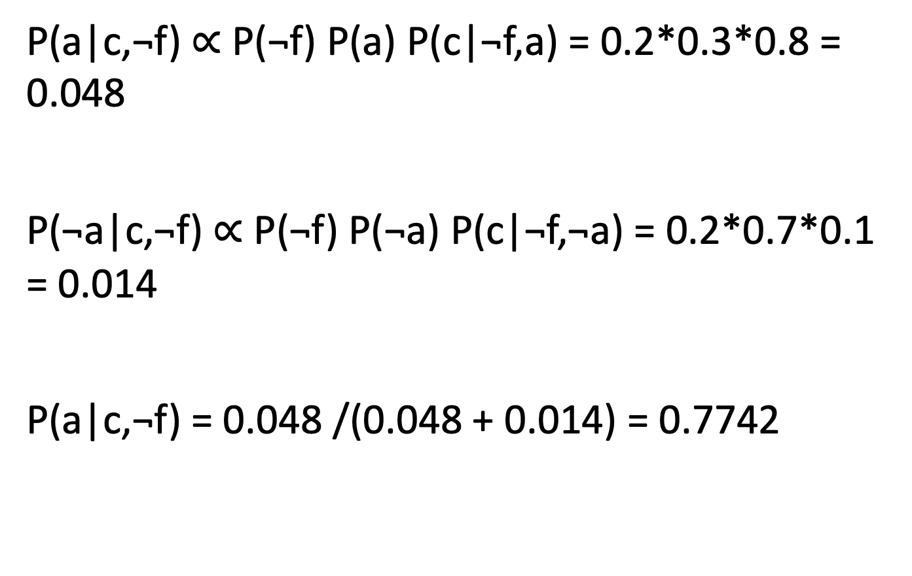
Q7.2
P(a|c,¬f) $∝$ P(¬f) P(a) P(c|¬f,a) = 0.2*0.3*0.8 = 0.048
P(¬a|c,¬f) $∝$ P(¬f) P(¬a) P(c|¬f,¬a) = 0.2*0.7*0.1 = 0.014
P(a|c,¬f) = 0.048 /(0.048 + 0.014) = 0.7742

Slide 14
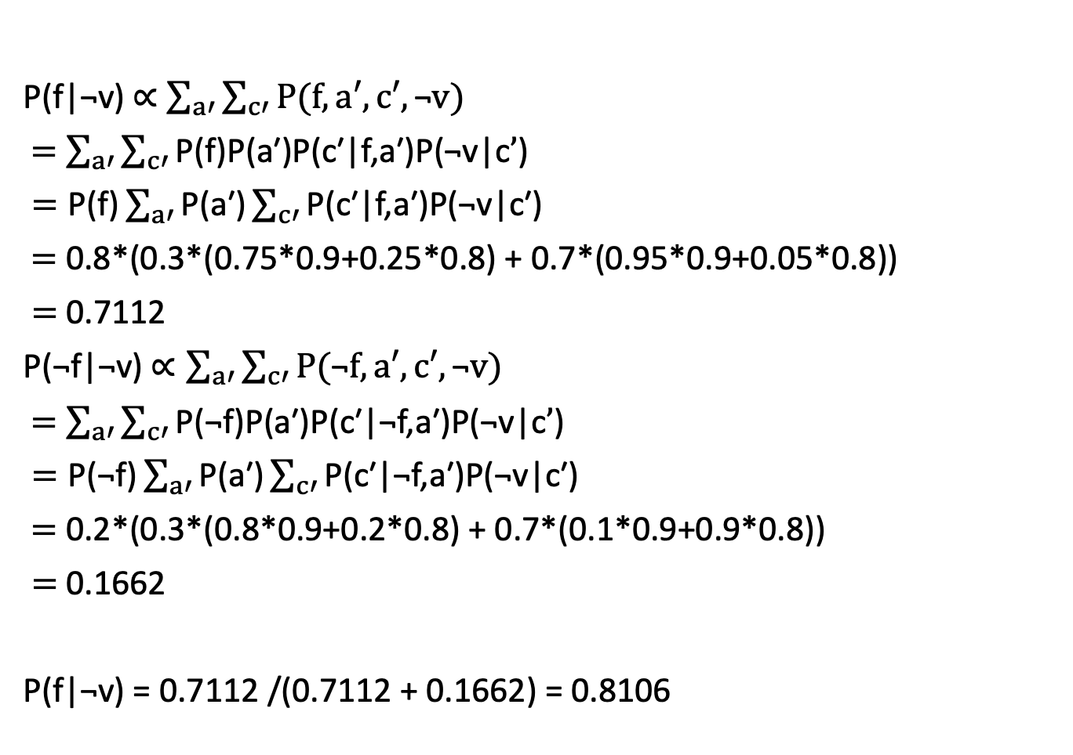
Q8
P(f|¬v) $∝$ $\sum_{a′}{\sum_{c′}{P(f,a′,c′,\text{¬}v)}}$
$=$ $\sum_{a′}{\sum_{c′}{\text{P}\text{(}\text{f}\text{)}\text{P}\text{(}\text{a}\text{′}\text{)}\text{P}\text{(}\text{c}\text{′}\text{|}\text{f}\text{,}\text{a}\text{′}\text{)}\text{P}\text{(¬}\text{v}\text{|}\text{c}’\text{)}}}$
$=\text{P}\text{(}\text{f}\text{)}\sum_{a′}{\text{P}\text{(}\text{a}\text{′)}\sum_{c′}{\text{P}\text{(}\text{c}\text{′|}\text{f}\text{,}\text{a}\text{′)}\text{P}\text{(¬}\text{v}\text{|}\text{c}\text{′)}}}$
$=$ 0.8*(0.3*(0.75*0.9+0.25*0.8) + 0.7*(0.95*0.9+0.05*0.8))
$=$ 0.7112
P(¬f|¬v) $∝\sum_{a′}{\sum_{c′}{P(\text{¬}f,a′,c′,\text{¬}v)}}$
$=$ $\sum_{a′}{\sum_{c′}{\text{P}\text{(¬}\text{f}\text{)}\text{P}\text{(}\text{a}\text{′)}\text{P}\text{(}\text{c}\text{′|¬}\text{f}\text{,}\text{a}\text{′)}\text{P}\text{(¬}\text{v}\text{|}\text{c}’\text{)}}}$
$=\text{P}\text{(¬}\text{f}\text{)}\sum_{a′}{\text{P}\text{(}\text{a}\text{′)}\sum_{c′}{\text{P}\text{(}\text{c}\text{′|¬}\text{f}\text{,}\text{a}\text{′)}\text{P}\text{(¬}\text{v}\text{|}\text{c}\text{′)}}}$
$=$ 0.2*(0.3*(0.8*0.9+0.2*0.8) + 0.7*(0.1*0.9+0.9*0.8))
$=$ 0.1662
P(f|¬v) = 0.7112 /(0.7112 + 0.1662) = 0.8106

Slide 15
Q9
(a). Not true. Violation of D-Separation Case 3.
(b). Not true. Not any case.

Slide 16
Q10
(a). True. D-Separation Case 2.
(b). Not true, not any case.
(c). True. D-Separation Case 1.
(d). True. D-Separation Case 1.

Slide 17
Q11.1
Without: 2⁸-1
1
2
2
2
With
S₁
S₂
S₃
S₄
2x8-1=15 parameters
Z₁
Z₂
Z₃
Z₄
2
2
2
2
Based on Slides in class

Slide 18
Q11.2
Without: 3⁸-1
2
6
6
6
With
S₁
S₂
S₃
S₄
2+6*7=44 parameters
Z₁
Z₂
Z₃
Z₄
6
6
6
6
S₁ could be any of three potential values a, b, and c, so P(S₁) needs 2 parameters.
For each S₁ value (out of 3), there are 2 parameters, so P(Z₁|S₁) needs 3*2=6 parameters.
Same for P(Z₂|S₂), P(Z₃|S₃), and P(Z₄|S₄)
Same for P(S₂|S₁), P(S₃|S₂), and P(S₄|S₃)

Slide 19
Q12.1
P(S₂=¬s|Z₁=o)
= P(S₂=¬s|S₁=s, Z₁=o) P(S₁=s|Z₁=o) + P(S₂=¬s|S₁=¬s, Z₁=o) P(S₁=¬s|Z₁=o)
= P(S₂=¬s|S₁=s) P(S₁=s|Z₁=o) + P(S₂=¬s|S₁=¬s) P(S₁=¬s|Z₁=o)
= 0.1*(1-0.16) +0.8*0.16
= 0.212

Slide 20
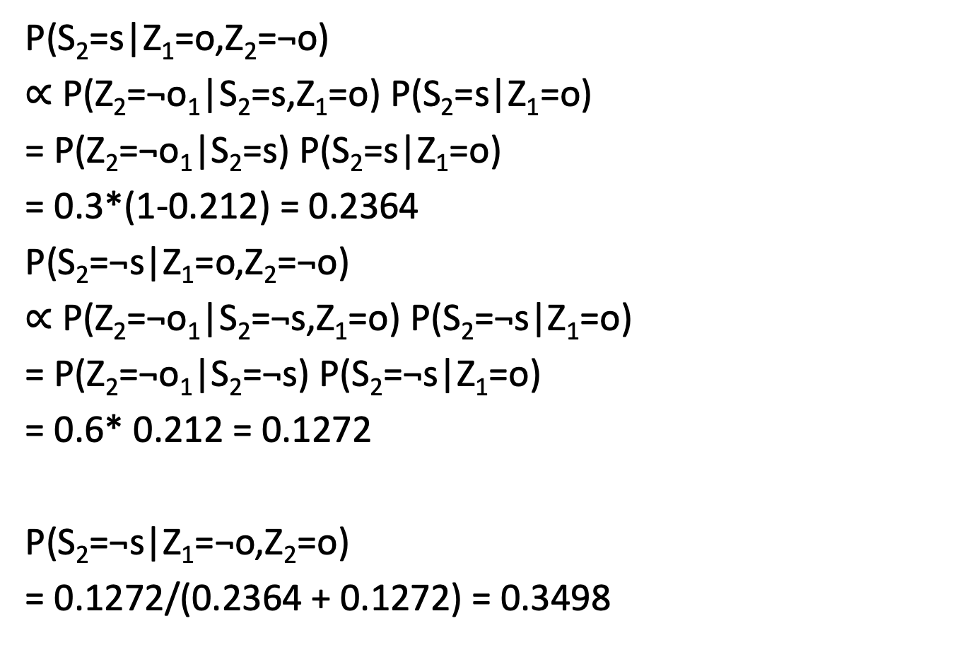
Q12.2
P(S₂=s|Z₁=o,Z₂=¬o)
$∝$ P($\text{Z}\text{2}\text{=¬}\text{o}\text{1}$|S₂=s,Z₁=o) P(S₂=s|Z₁=o)
= P($\text{Z}\text{2}\text{=¬}\text{o}\text{1}$|S₂=s) P(S₂=s|Z₁=o)
= 0.3*(1-0.212) = 0.2364
P(S₂=$\text{¬}$s|Z₁=o,Z₂=¬o)
$∝$ P($\text{Z}\text{2}\text{=¬}\text{o}\text{1}$|S₂=$\text{¬}$s,Z₁=o) P(S₂=$\text{¬}$s|Z₁=o)
= P($\text{Z}\text{2}\text{=¬}\text{o}\text{1}$|S₂=$\text{¬}$s) P(S₂=$\text{¬}$s|Z₁=o)
= 0.6* 0.212 = 0.1272
P(S₂=$\text{¬}$s|Z₁=¬o,Z₂=o)
= 0.1272/(0.2364 + 0.1272) = 0.3498

Slide 21

Q14.1
After motion:
${μ=μ}_{1}+μ_{2}$ = 2+3 = 5
$σ^{2}={σ_{1}}^{2}{{+σ}_{2}}^{2}$ = 5+7 = 12

Slide 22

Q14.2
After sensing:
$μ=\frac{{{μ_{1}σ}_{2}}^{2}{{+μ_{2}σ}_{1}}^{2}}{{σ_{1}}^{2}{{+σ}_{2}}^{2}}$ = $\frac{5∗4+1∗12}{12+4}$ = 2
$σ^{2}=\frac{1}{\frac{1}{{σ_{1}}^{2}}+\frac{1}{{σ_{2}}^{2}}}$ = $\frac{1}{\frac{1}{12}+\frac{1}{4}}$ = 3

